Slide 1



Airline Flight Performance Dashboard
Page
01
Introduction!!
The Airline Flight Performance Dashboard is a data analytics project designed to analyze airline operations, financial performance, flight delays, passenger occupancy, and customer satisfaction.
The dashboard uses an airline dataset containing 500 flight records, covering various airlines, routes, aircraft types, and cabin classes. It presents important information through Key Performance Indicators (KPIs), charts, and interactive filters.
The main objective of this project is to transform raw flight data into meaningful insights that can help identify operational issues, monitor financial performance, and improve the overall passenger experience.
Tools and Technologies: Dataset in CSV format, Python, Google Colab, HTML, and interactive data visualization.

Slide 2


KPI Summary
Page
02
Key Performance Indicators (KPIs) provide a quick overview of airline performance.
The following KPIs are calculated from the dataset:
1. Total Flights: 500
The dataset contains 500 flight records used to analyze airline performance.
2. Total Revenue: ₹69.49 Crore
This represents the combined revenue generated by all recorded flights.
3. Total Profit: ₹26.27 Crore
This indicates the total recorded profit after accounting for operating costs.
4. Average Load Factor: 80.6%
On average, approximately 80.6% of available seats were occupied, indicating passenger demand relative to seat capacity.
5. Average Recorded Delay: 25.49 Minutes
The average value of the recorded delay field is approximately 25.49 minutes across all flight records. This includes the dataset's recorded values for different flight statuse
6. Average Customer Rating: 3.92 out of 5
The average rating suggests generally positive passenger feedback, although there is room for improvement.

Slide 3
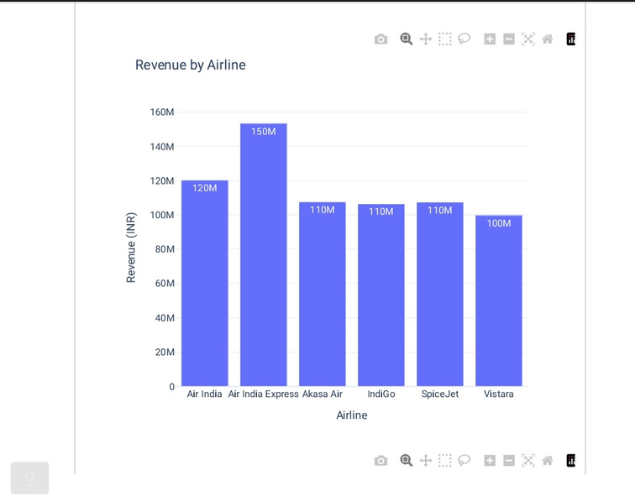
Revenue analysis
Page
03
Revenue analysis examines the financial performance of different airlines and identifies which airlines contribute the most to total revenue.
According to the dataset, the total recorded revenue is approximately ₹69.49 crore
The revenue generated by each airline is as follows:
Air India Express: ₹15.35 crore
Air India: ₹12.03 crore
Akasa Air: ₹10.76 crore
SpiceJet: ₹10.74 crore
IndiGo: ₹10.64 crore
Vistara: ₹9.97 crore
Analysis:
Air India Express recorded the highest total revenue among the airlines in this dataset, while Vistara recorded the lowest.

Slide 4
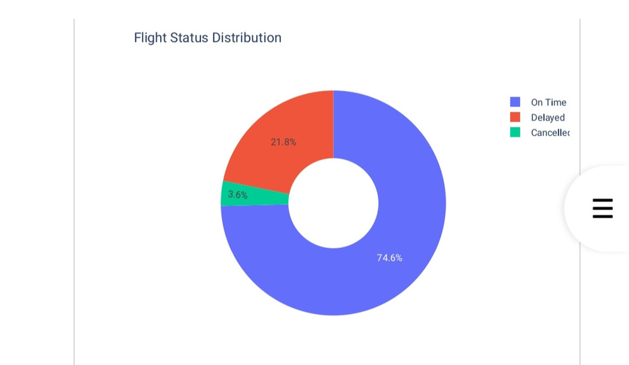
Flight Status Analysis
Page
04
Flight status analysis examines how many flights were recorded as on time, delayed, or cancelled.
The dataset contains the following flight status distribution:
On-Time Flights: 373 flights
Delayed Flights: 109 flights
Cancelled Flights: 18 flights
The percentages are approximately:
On time: 74.6%
Delayed: 21.8%
Cancelled: 3.6%
Analysis:
The majority of flights were recorded as on time, representing 74.6% of all flight records.
However, 21.8% of flights were classified as delayed, indicating an opportunity to investigate operational inefficiencies.
The remaining 3.6% were cancelled.
Airlines can use this information to identify patterns in delays and cancellations and investigate possible causes, such as scheduling issues, weather conditions, or operational constraints. The dataset alone does not establish the actual causes.

Slide 5
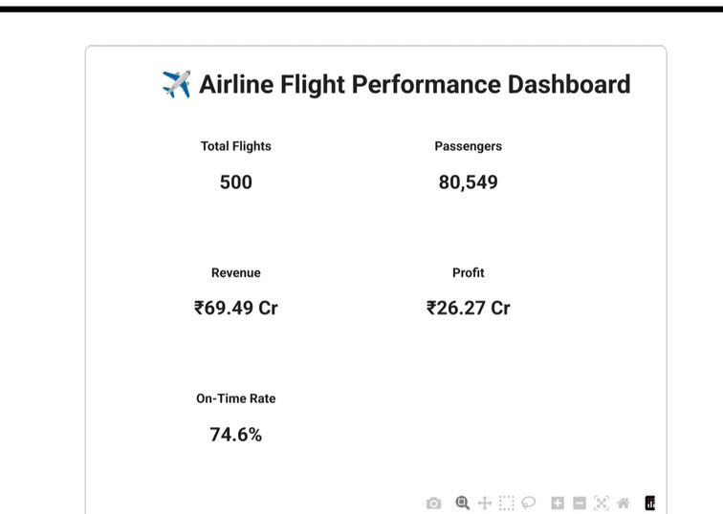
Key Findings
Page
05
The analysis of the Airline Flight Performance Dashboard reveals several important findings:
1. Strong Recorded Revenue
The dataset shows total revenue of approximately ₹69.49 crore, demonstrating the financial scale of the recorded flight operations.
2. Air India Express Leads in Revenue
Air India Express generated the highest recorded revenue among the six airlines, contributing approximately ₹15.35 crore.
3. Most Flights Were On Time
Approximately 74.6% of recorded flights were classified as on time, indicating that most flights met their recorded operational status.
4. Flight Delays Require Attention
Approximately 21.8% of flights were delayed. Further analysis could help identify airlines, routes, or periods associated with frequent delays.
5. Good Passenger Occupancy
The average load factor was 80.6%, suggesting that a substantial proportion of available seats were occupied.
6. Customer Satisfaction Can Be Improved
The average customer rating was 3.92 out of 5. Airlines can investigate customer feedback, delays, and baggage-related issues to identify opportunities to improve the passenger experience.
7. Financial and Operational Performance Should Be Evaluated Together
Revenue alone does not provide a complete picture of airline performance. Profit, delays, passenger occupancy, and customer ratings should also be considered.

Slide 6

Recommendation
Page
06
Based on the analysis, the following recommendations can help improve airline performance:
1. Reduce Flight Delays
Airlines should investigate the routes and time periods associated with frequent or lengthy delays and review scheduling and operational procedures.
2. Improve Revenue Performance
Airlines should compare revenue across routes, airlines, and cabin classes to identify opportunities for better financial performance.
3. Optimize Seat Capacity
Flights with consistently low load factors should be reviewed to understand passenger demand and determine whether capacity adjustments are appropriate.
4. Enhance Customer Satisfaction
Airlines should monitor customer ratings and feedback to identify service issues and improve the passenger experience.
5. Monitor Profitability
Revenue and profit should be analyzed together to understand which operations generate stronger financial results.
6. Track Baggage Claims
Monitoring baggage claims can help airlines identify recurring service problems and improve baggage-handling procedures.
7. Use Interactive Filters
Users should apply filters for airline, flight status, route, and date to investigate specific performance issues and compare different segments.
8. Update the Dataset Regularly
Regularly refreshing the dataset will help users monitor changes in performance and make decisions using more recent information.

Slide 7


Conclusion
Page
07
Although most recorded flights were on time, the proportion of delayed flights highlights an important area for further investigation.
Overall, this project demonstrates how data analytics and visualization can convert raw airline data into meaningful insights. The dashboard supports performance monitoring, helps identify potential improvement areas, and provides a foundation for data-driven decision-making.
The Airline Flight Performance Dashboard provides a clear and organized overview of airline operations, revenue, profitability, flight status, passenger occupancy, and customer satisfaction.
The analysis of 500 flight records shows total revenue of approximately ₹69.49 crore, total profit of ₹26.27 crore, an average load factor of 80.6%, and an average customer rating of 3.92 out of 5.

Slide 8
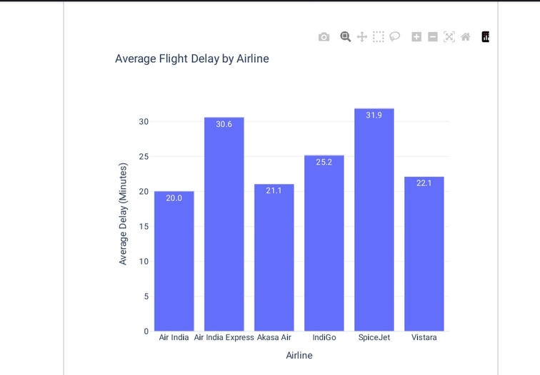
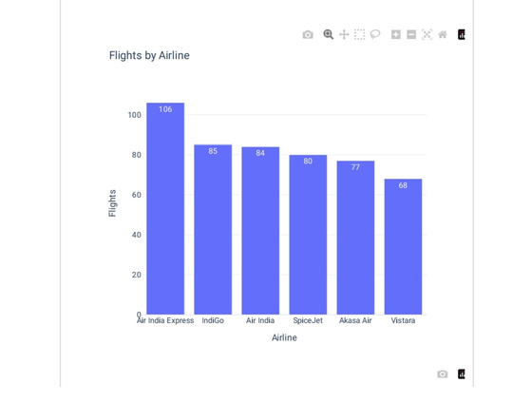
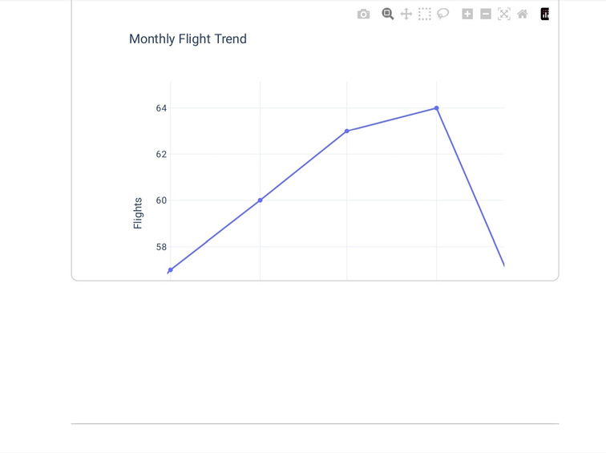
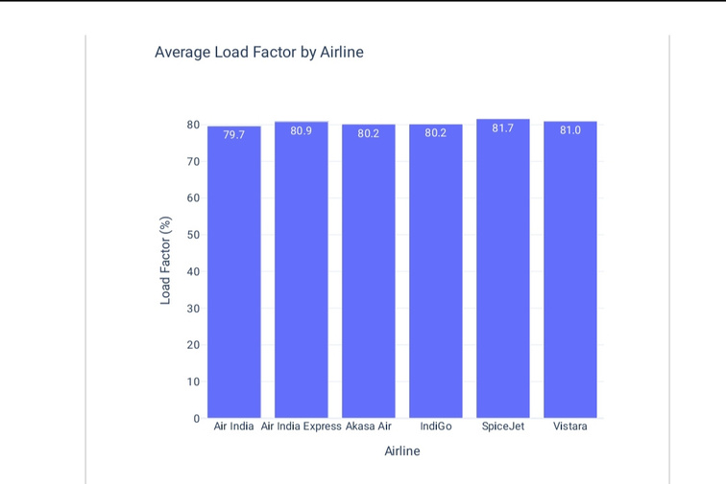
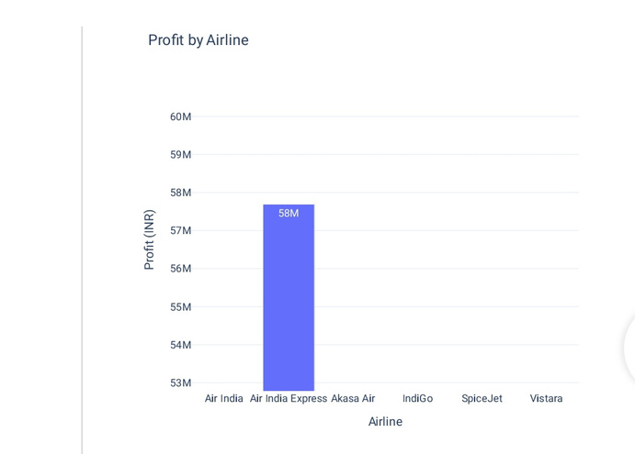
Charts & graphs

